Slide 1
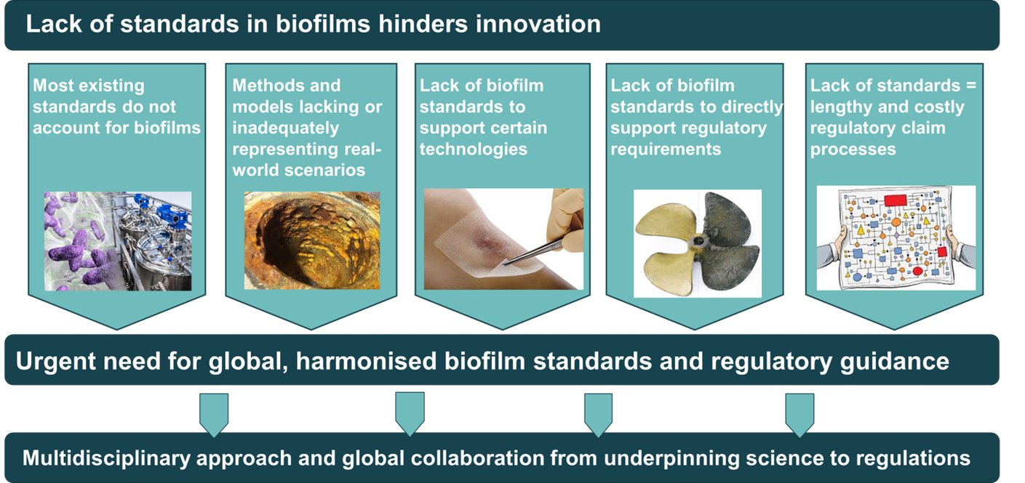



Biofilm Alliance – A Regulatory Science Network
Paulina Rakowska, Geertje Van Keulen, Gillian Iredale, James Redfern, Peter Askew, Jay Shanga, William Green, Anthony Horlock, Natalie De Mello, Hollie Leighton
Despite the significant impact of biofilms on health, the environment, and industry, resulting in an estimated economic cost of US$5 trillion annually, progress in biofilm control, management, and prevention is hindered by challenges in regulatory sciences. Outdated guidelines, limited collaboration between researchers, industry, and regulators, and the absence of standardised biofilm methodologies create the urgent need for a systematic approach.
To address these challenges, a collaborative network - the Biofilm Alliance - has been established in the UK, to bring together academic experts, industry professionals, regulatory authorities, and metrology and standardisation bodies. Supported by the Innovate UK, this initiative aims to assess and recommend existing methodologies and models, as well as develop a structured framework for interpreting biofilm data, ultimately leading to a set of recommended regulatory tools.
Challenges
Current biofilm research and innovation outpaces existing regulatory guidelines.
Limited dialogue between regulators, biofilm researchers, and industry innovators.
Diversity of biofilm-affected industries, lack of cross-sector engagement, and varied nature of the biofilm research.
General absence of standardised biofilm methodologies.
Knowledge relating to regulatory decision-making regarding biofilm technologies lacking in the UK.
Key Focus Areas
OBJECTIVES
Industrial Processes
Addressing the impact of biofilms on manufacturing efficiency and contamination risks.
Data Collection and Gap Analysis in biofilm-related regulations through surveys, interviews, and workshops.
Development of an Expertise Register to connect regulatory and industry stakeholders with leading biofilm experts.
Creation of a catalogue of regulatory tools to support regulatory decision-making.
Provision of training modules and educational resources to support innovation and compliance.
Working closely with UK regulators to address regulatory challenges and improve biofilm-related standards.
Through comprehensive reports and active participation in regulatory discussions, we aim to shape policies that support biofilm innovation.
Built Environment
Understanding and mitigating the impact of biofilms in buildings and infrastructure.
Food
Managing biofilm risks in food production, processing, storage, and packaging.
Water Systems
Tackling biofilm formation in drinking water, wastewater treatment, wet leisure, and industrial water applications.
Growing Network
Join us or Get In Touch!
W: www.biofilm-alliance.org
E: contact@biofilm-alliance.org
Follow us on LinkedIn →

